Slide 1
Lempel-Ziv Compression Techniques
Classification of Lossless Compression techniques
Introduction to Lempel-Ziv Encoding: LZ77 & LZ78
LZ78 Encoding Algorithm
LZ78 Decoding Algorithm

Slide 2
Classification of Lossless Compression Techniques
Recall what we studied before:
Lossless Compression techniques are classified into static, adaptive (or dynamic), and hybrid.
Static coding requires two passes: one pass to compute probabilities
(or frequencies) and determine the mapping, and a second pass to encode.
Examples of Static techniques: Static Huffman Coding
All of the adaptive methods are one-pass methods; only one scan of the message is required.
Examples of adaptive techniques: LZ77, LZ78, LZW, and Adaptive Huffman Coding

Slide 3
Introduction to Lempel-Ziv Encoding
Data compression up until the late 1970's mainly directed towards creating better methodologies for Huffman coding.
An innovative, radically different method was introduced in1977 by Abraham Lempel and Jacob Ziv.
This technique (called Lempel-Ziv) actually consists of two considerably different algorithms, LZ77 and LZ78.
Due to patents, LZ77 and LZ78 led to many variants:
The zip and unzip use the LZH technique while UNIX's compress methods belong to the LZW and LZC classes.
LZ77 Variants | LZR | LZSS | LZB | LZH
LZ78 Variants | LZW | LZC | LZT | LZMW | LZJ | LZFG

Slide 4
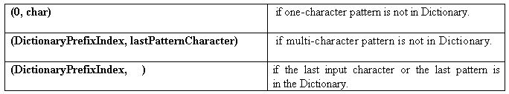
LZ78 Compression Algorithm
LZ78 inserts one- or multi-character, non-overlapping, distinct patterns of
the message to be encoded in a Dictionary.
The multi-character patterns are of the form: C₀C₁ . . . C_{n-1}C_{n}. The prefix of
a pattern consists of all the pattern characters except the last: C₀C₁ . . . C_{n-1}
LZ78 Output:
Note: The dictionary is usually implemented as a hash table.

Slide 5
LZ78 Compression Algorithm (cont’d)
Dictionary ← empty ; Prefix ← empty ; DictionaryIndex ← 1;
while(characterStream is not empty)
{
Char ← next character in characterStream;
if(Prefix + Char exists in the Dictionary)
Prefix ← Prefix + Char ;
else
{
if(Prefix is empty)
CodeWordForPrefix ← 0 ;
else
CodeWordForPrefix ← DictionaryIndex for Prefix ;
Output: (CodeWordForPrefix, Char) ;
insertInDictionary( ( DictionaryIndex , Prefix + Char) );
DictionaryIndex++ ;
Prefix ← empty ;
}
}
if(Prefix is not empty)
{
CodeWordForPrefix ← DictionaryIndex for Prefix;
Output: (CodeWordForPrefix , ) ;
}

Slide 6
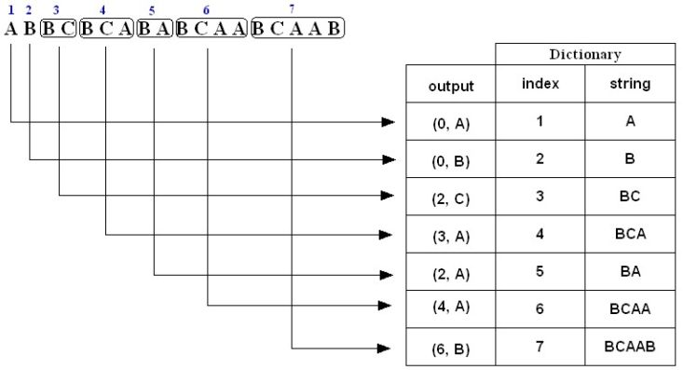
Example 1: LZ78 Compression
Encode (i.e., compress) the string ABBCBCABABCAABCAAB using the LZ78 algorithm.
The compressed message is: (0,A)(0,B)(2,C)(3,A)(2,A)(4,A)(6,B)
Note: The above is just a representation, the commas and parentheses are not transmitted; we will discuss the actual form of the compressed message later on in slide 12.

Slide 7
Example 1: LZ78 Compression (cont’d)
1. A is not in the Dictionary; insert it
2. B is not in the Dictionary; insert it
3. B is in the Dictionary.
BC is not in the Dictionary; insert it.
4. B is in the Dictionary.
BC is in the Dictionary.
BCA is not in the Dictionary; insert it.
5. B is in the Dictionary.
BA is not in the Dictionary; insert it.
6. B is in the Dictionary.
BC is in the Dictionary.
BCA is in the Dictionary.
BCAA is not in the Dictionary; insert it.
7. B is in the Dictionary.
BC is in the Dictionary.
BCA is in the Dictionary.
BCAA is in the Dictionary.
BCAAB is not in the Dictionary; insert it.

Slide 8
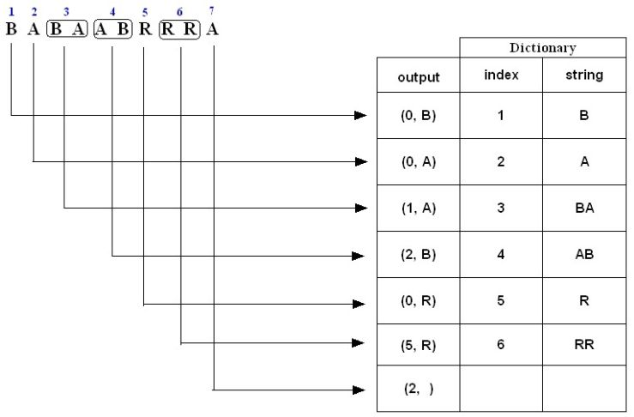
Example 2: LZ78 Compression
Encode (i.e., compress) the string BABAABRRRA using the LZ78 algorithm.
The compressed message is: (0,B)(0,A)(1,A)(2,B)(0,R)(5,R)(2, )

Slide 9
Example 2: LZ78 Compression (cont’d)
1. B is not in the Dictionary; insert it
2. A is not in the Dictionary; insert it
3. B is in the Dictionary.
BA is not in the Dictionary; insert it.
4. A is in the Dictionary.
AB is not in the Dictionary; insert it.
5. R is not in the Dictionary; insert it.
6. R is in the Dictionary.
RR is not in the Dictionary; insert it.
7. A is in the Dictionary and it is the last input character; output a pair
containing its index: (2, )

Slide 10
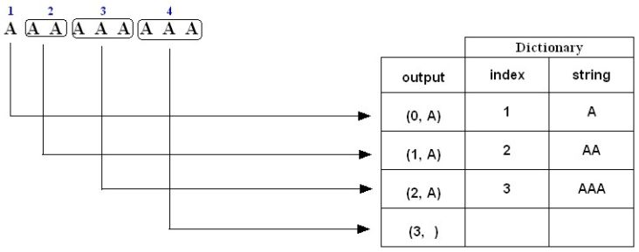
Example 3: LZ78 Compression
Encode (i.e., compress) the string AAAAAAAAA using the LZ78 algorithm.
1. A is not in the Dictionary; insert it
2. A is in the Dictionary
AA is not in the Dictionary; insert it
3. A is in the Dictionary.
AA is in the Dictionary.
AAA is not in the Dictionary; insert it.
4. A is in the Dictionary.
AA is in the Dictionary.
AAA is in the Dictionary and it is the last pattern; output a pair containing its index:
(3, )

Slide 11
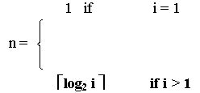
LZ78 Compression: Number of bits transmitted
Example: Uncompressed String: ABBCBCABABCAABCAAB
Number of bits = Total number of characters * 8
= 18 * 8
= 144 bits
Suppose the codewords are indexed starting from 1:
Compressed string( codewords): (0, A) (0, B) (2, C) (3, A) (2, A) (4, A) (6, B)
Codeword index 1 2 3 4 5 6 7
Each code word consists of an integer and a character:
  The character is represented by 8 bits.
  The number of bits n required to represent the integer part of the codeword with
  index i is given by:
Alternatively number of bits required to represent the integer part of the codeword
with index i is the number of significant bits required to represent the integer i – 1

Slide 12
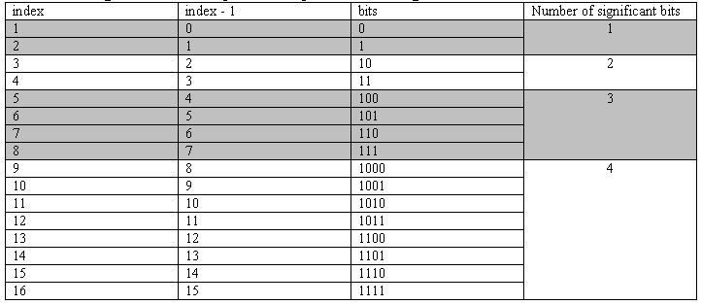
LZ78 Compression: Number of bits transmitted (cont’d)
Codeword (0, A) (0, B) (2, C) (3, A) (2, A) (4, A) (6, B)
index 1 2 3 4 5 6 7
Bits: (1 + 8) + (1 + 8) + (2 + 8) + (2 + 8) + (3 + 8) + (3 + 8) + (3 + 8) = 71 bits
The actual compressed message is: 0A0B10C11A010A100A110B
where each character is replaced by its binary 8-bit ASCII code.

Slide 13
LZ78 Decompression Algorithm
Dictionary ← empty ; DictionaryIndex ← 1 ;
while(there are more (CodeWord, Char) pairs in codestream){
CodeWord ← next CodeWord in codestream ;
Char ← character corresponding to CodeWord ;
if(CodeWord = = 0)
String ← empty ;
else
String ← string at index CodeWord in Dictionary ;
Output: String + Char ;
insertInDictionary( (DictionaryIndex , String + Char) ) ;
DictionaryIndex++;
}
Summary:
  input: (CW, character) pairs
  output:
if(CW == 0)
output: currentCharacter
else
output: stringAtIndex CW + currentCharacter
  Insert: current output in dictionary

Slide 14
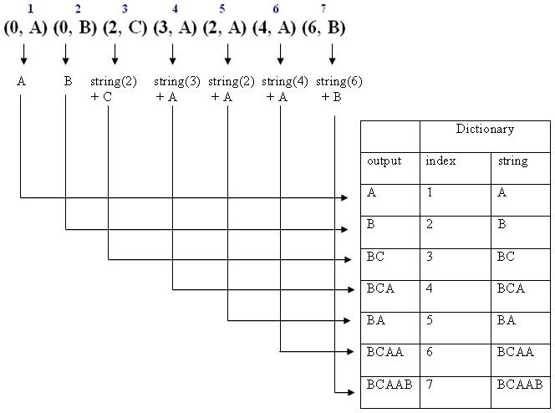
Example 1: LZ78 Decompression
Decode (i.e., decompress) the sequence (0, A) (0, B) (2, C) (3, A) (2, A) (4, A) (6, B)
The decompressed message is: ABBCBCABABCAABCAAB

Slide 15
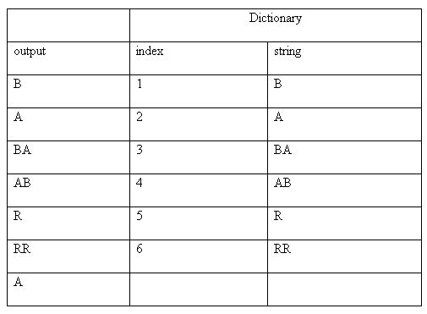
Example 2: LZ78 Decompression
Decode (i.e., decompress) the sequence (0, B) (0, A) (1, A) (2, B) (0, R) (5, R) (2, )
The decompressed message is: BABAABRRRA

Slide 16
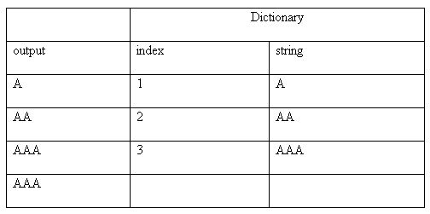
Example 3: LZ78 Decompression
Decode (i.e., decompress) the sequence (0, A) (1, A) (2, A) (3, )
The decompressed message is: AAAAAAAAA

Slide 17
Exercises
1. Use LZ78 to trace encoding the string
SATATASACITASA.
2. Write a Java program that encodes a given string using LZ78.
3. Write a Java program that decodes a given set of encoded codewords using LZ78.

